Slide 1
Announcements
HW5 – Perceptrons and Neural Nets has been released. When do you want it to be due?
Tuesday August 6
Tuesday August 13
The final project is due Wednesday August 7. If you’re doing the group R2D2 project, you should give a 5 minute presentation to describe what you did and show off your robots in action.
The final exam is in-class on Friday August 9. It will be mainly multiple choice questions similar to the quizzes, and it will cover all of the assigned readings.

Slide 2

Bayes’ Nets - Wrapup
Read AIMA Chapter 14 ”Probabilistic Reasoning" (Sections 14.1, 14.2 and 14.4)
Slides courtesy of Dan Klein and Pieter Abbeel --- University of California, Berkeley
[These slides were created by Dan Klein and Pieter Abbeel for CS188 Intro to AI at UC Berkeley. All CS188 materials are available at http://ai.berkeley.edu.]
Notes:
Please retain proper attribution, including the reference to ai.berkeley.edu. Thanks!

Slide 3
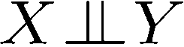
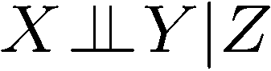
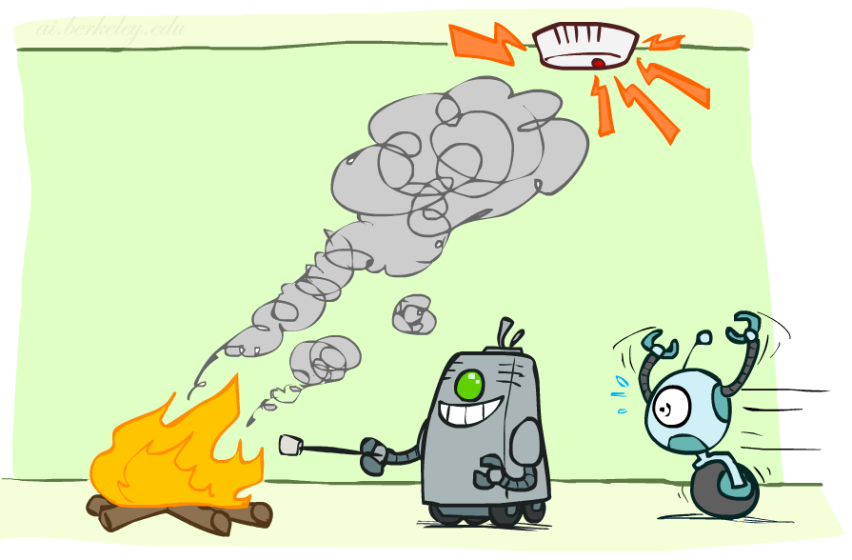
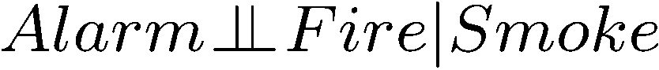
Conditional Independence
X and Y are independent if
X and Y are conditionally independent given Z
(Conditional) independence is a property of a distribution
Example:

Slide 4

Conditional Independence
Unconditional (absolute) independence very rare, and it doesn’t help us make inferences about other variables.
Conditional independence is our most basic and robust form of knowledge about uncertain environments.
X is conditionally independent of Y given Z
if and only if:
or, equivalently, if and only if
Notes:
How do we prove that? Let’s prove that the first one implies the second.
1) First, let’s start with the definition of the conditional… P(x|z,y) = P(z,y,z) / P(y,z)
2) Now we want to incorporate our assumption, since that’s critical to what we want to prove. So let’s re-write the numerator as P(z)* P(z,y|z) which is just the definition of the joint. Keep the denominator for now.
3) Let’s use our assumption, to rewrite the numerator as P(z) * (Px|z) * P(y|z). Then we can re-write the denominator as P(z)*P(y|z), and cancel terms to find that P(X|Z,Y) = P(X|Z).
Also equivalent: For All x,y,z: P(y|z,x) = P(y|z)

Slide 5
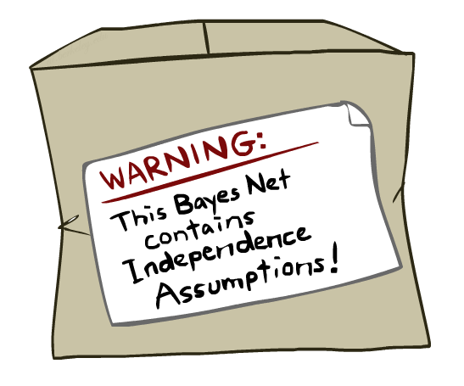
Bayes Nets: Assumptions
Assumptions we are required to make to define the Bayes net when given the graph:
Beyond the “chain rule → Bayes net” conditional independence assumptions
There are often additional conditional independences
They can be read off the graph
Important for modeling: understand assumptions made when choosing a Bayes net graph
Notes:
We encode some conditional independencies explicitly.
However, there are almost always some additional conditional independence assumptions that are present. And they can be read off the graph.

Slide 6
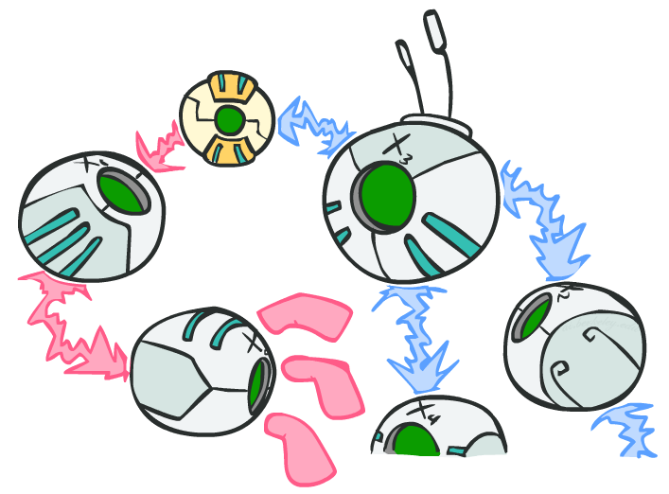
D-separation: Outline
Notes:
Study independence properties for triples
Analyze complex cases in terms of member triples
D-separation: a condition / algorithm for answering such queries
D is for Descendants.

Slide 7
D-separation: Outline
Study independence properties for triples
Analyze complex cases in terms of member triples
D-separation: a condition / algorithm for answering such queries

Slide 8
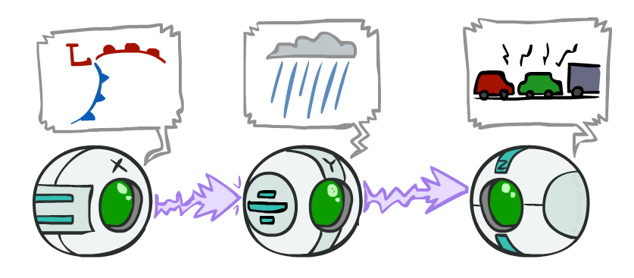
Recap: Causal Chains
This configuration is a “causal chain”
Guaranteed X independent of Z ? No!
One example set of CPTs for which X is not independent of Z is sufficient to show this independence is not guaranteed.
Example:
Low pressure causes rain causes traffic,
high pressure causes no rain causes no
traffic
In numbers:
P( +y | +x ) = 1, P( -y | - x ) = 1,
P( +z | +y ) = 1, P( -z | -y ) = 1
X: Low pressure Y: Rain Z: Traffic
Notes:
The numbers show a deterministic chain. It renders X and Z not independent. X is always == Z.

Slide 9
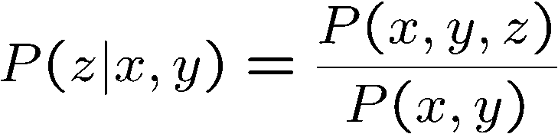
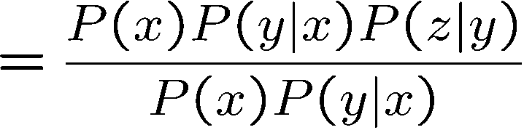
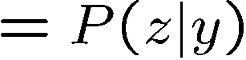
Recap: Causal Chains
This configuration is a “causal chain”
Guaranteed X independent of Z given Y?
Evidence along the chain “blocks” the influence
X: Low pressure Y: Rain Z: Traffic
Yes!
Notes:
Show what cancels out.
The assumptions that are available to us are given by P(X,Y,X) = P(X) P(Y|X) P(Z|Y)

Slide 10
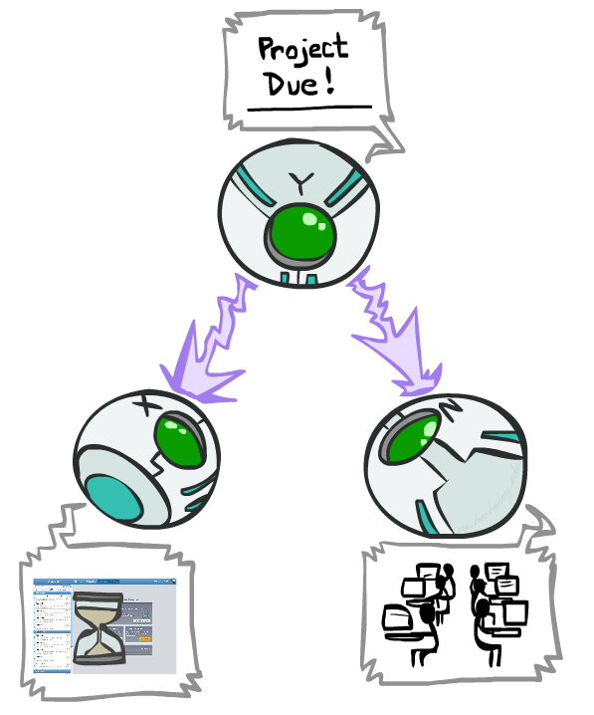
Recap: Common Cause
This configuration is a “common cause”
Guaranteed X independent of Z ? No!
One example set of CPTs for which X is not independent of Z is sufficient to show this independence is not guaranteed.
Example:
Project due causes both forums busy
and office hours to be full
In numbers:
P( +x | +y ) = 1, P( -x | -y ) = 1,
P( +z | +y ) = 1, P( -z | -y ) = 1
Y: Project due
X: Forums busy
Z: Office hours full
Notes:
If X is always equal to Y and Z is always equal to Y, then they’re not independent.

Slide 11
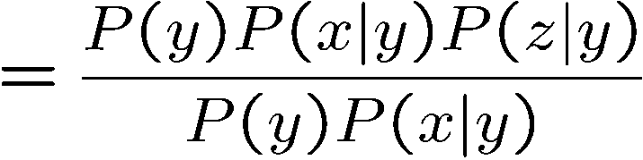
Recap: Common Cause
This configuration is a “common cause”
Guaranteed X and Z independent given Y?
Observing the cause blocks influence between effects.
Y: Project due
X: Forums busy
Z: Office hours full
Yes!

Slide 12
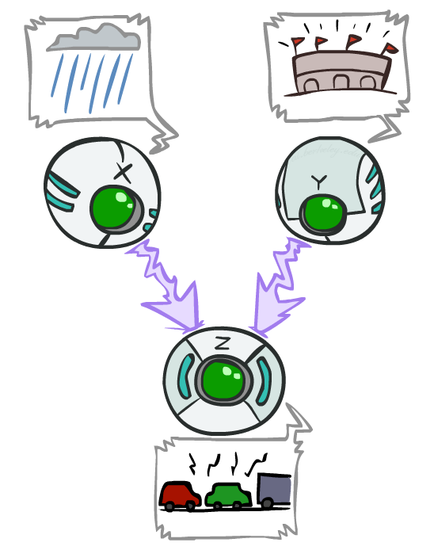
Recap: Common Effect
Last configuration: two causes of one effect (v-structures)
Are X and Y independent?
Yes: the ballgame and the rain cause traffic, but they are not correlated
Still need to prove they must be (try it!)
Are X and Y independent given Z?
No: seeing traffic puts the rain and the ballgame in competition as explanation.
This is backwards from the other cases
Observing an effect activates influence between possible causes.
X: Raining
Y: Ballgame
Z: Traffic
Notes:
Special case where observing the thing in the middle make things depend on each other. You have two causes. One of the causes must be true. Observing one of the causes to be true, means that the second cause doesn’t have to be true. Seeing one explains away the need for the other.
From the Bayes net we know that:
P(C,B,E) = P(C) P(B) P(E | B, C)
we can sum over E on both sides:
Σ_ E P(C,B,E) = Σ_E P(C) P(B) P(E | B, C)
we can rearrange the righthand side to move the sub to what it scopes over:
Σ_E P(C,B,E) = P(C) P(B) Σ_E P(E | B, C)
the term Σ_E P(E | B, C) = 1, so we are left with:
P(C,B) = P(C) P(B)
which is the definition of independence.
Alternately we can use the independence assumptions that are encoded in all Bayes Nets.
X_i _||_ X_1 … X_i-1 – parents(X_i) | parents (X_i).
An ordering we could take here is X, Y, Z, so
X _||_ Y | empty set.

Slide 13
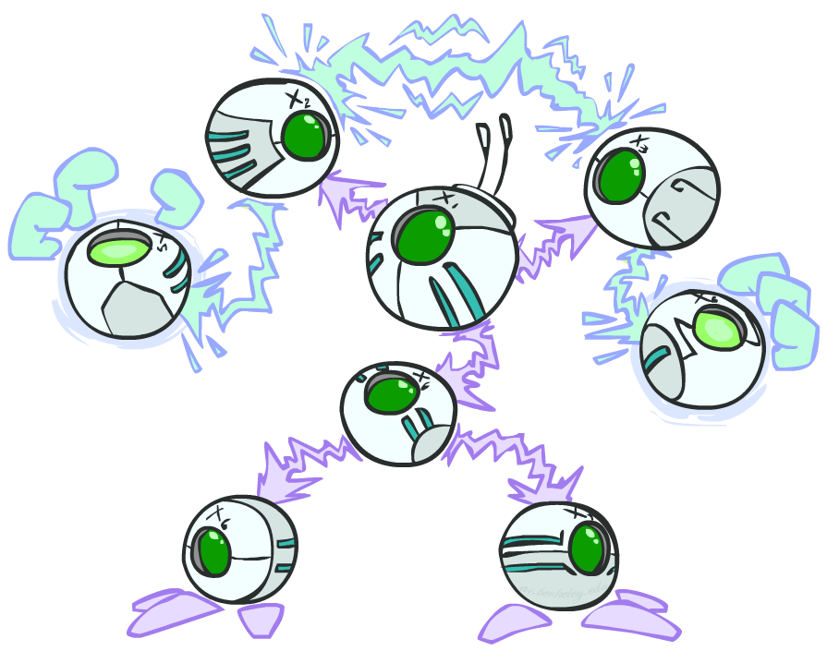
Are you variables in a BN independent?
General question: in a given BN, are two variables independent (given some evidence)?
Solution: analyze the graph
Any complex example can be broken
into repetitions of the three canonical cases
Notes:
Break the graph down to triples. Check if there is influence running along those triples. Analyze the graph. check everywhere in the graph where influence can run between two variables, or see if it is blocked.

Slide 14

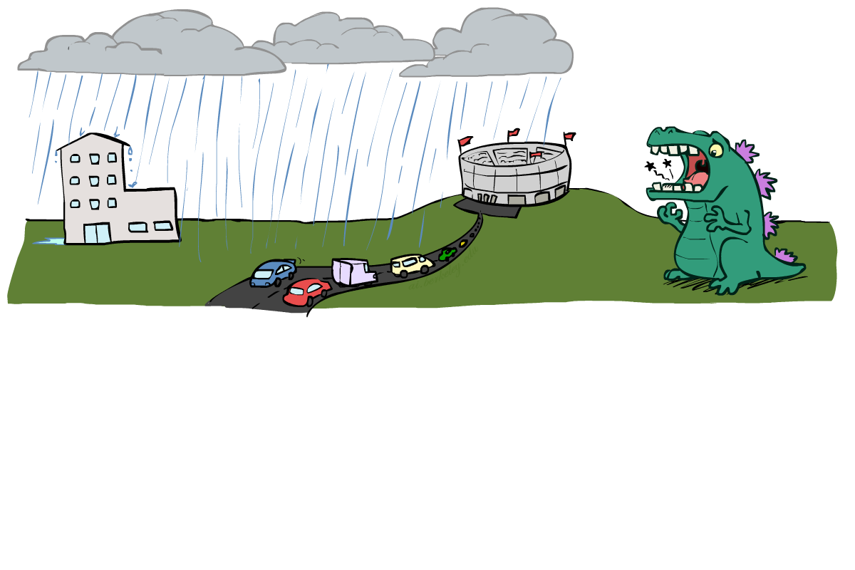
Reachability
L
Recipe: shade evidence nodes, look for paths in the resulting graph
Attempt 1: if two nodes are connected by an undirected path not blocked by a shaded node, they are conditionally independent
Almost works, but not quite
Where does it break?
Answer: the v-structure at T doesn’t count as a link in a path unless “active”
R
B
D
T
Notes:
First attempt: check whether there’s a path between two variables. Check whether it’s been blocked by some evidence. If not, then they are conditionally independent.
Too simple.
Observing T lets the influence run between R and B.

Slide 15
Active / Inactive Paths
Question: Are X and Y conditionally independent given evidence variables {Z}?
Yes, if X and Y “d-separated” by Z
Consider all (undirected) paths from X to Y
No active paths = independence!
A path is active if each triple is active:
Causal chain A → B → C where B is unobserved (either direction)
Common cause A ← B → C where B is unobserved
Common effect (aka v-structure)
A → B ← C where B or one of its descendants is observed
All it takes to block a path is a single inactive segment
Active Triples
Inactive Triples
Notes:
First one is a causal change. When the middle variable isn’t active, then there’s influence between the first and the third. However, once you observe the middle variable, it blocks the influences between them and makes them independent.
Second is the common cause. Same story.
Third is the common effect. This is the odd one out.
What does it mean to be an active triple or inactive triple in the larger context?
If every triple along a path is active, then we have an active path.
If one or more triples is in active, then the whole path is inactive.

Slide 16
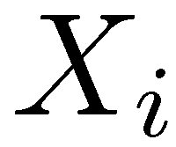
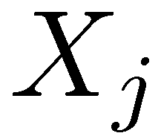

D-Separation
?
Query:
Check all (undirected!) paths between and
If one or more active, then independence not guaranteed
Otherwise (i.e. if all paths are inactive),
then independence is guaranteed
Notes:
Is it guaranteed to be true for Xi and Xj are independent given these variables and given this BN structure.
Just not guaranteed. It could be there or not. (If every distribution becomes a uniform distribution given the parent variables, then no dependencies)

Slide 17

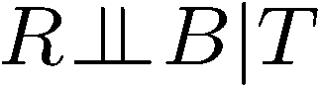
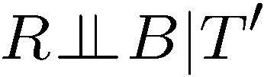
Example
Yes
R
B
T
T’
Notes:
T’: traffic report
Given T == T is observed. NO, not guaranteed to be true.
Given T’ == T’ is observed. NO, not guaranteed to be true.
R_||_B Yes – it’s got one path. It’s a common effect. It’s an inactive triple because the effect isn’t observed, and none of its children are observed. Therefore it’s an inactive triple and an inactive path, so independence is guaranteed.
R_||_B|T No –It’s a common effect. But now the effect is observed, so it’s an active triple. All of the triples along the path (there’s only one in this case), so the path is active. so independence is NOT guaranteed.
R_||_B|T’ How about when we condition on T1 instead of T? No –It’s still an active triple since one of the decedents of the effect is observed. All of the triples along the path (there’s only one in this case), so the path is active. so independence is NOT guaranteed.

Slide 18
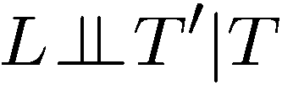

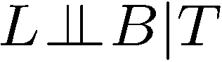
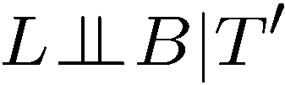
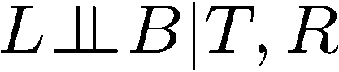
Example
L
Yes
R
B
Yes
D
T
Yes
T’
Notes:
L_||_T’|T – yes! Just one path. We need to check all triples. If one of the triples is inactive, then the whole path is inactive. So There’s two triples, one is inactive, so the whole path is inactive, so independence is guaranteed.
L_||_B – Yes! Two triples. B-T-R is an inactive triple, since it’s a common effect. So that makes the whole path inactive. There’s only one path, so independence is guaranteed.
L_||_B|T – No! The common effect is now active. So the path is active. First triple L-R-T, the third element is observed. That doesn’t actually matter. We only care about the middle node in the triples. 2nd one R-T-B the middle one is observed. Common effect is active.
L_||_B|T’ – No! Same as before. The descendent of a common effect is observed, so it’s active.
L_||_B|T,R – yes! How about with more observations. The L-R-T is a causal chain. The middle is observed, so its inactive. That makes the path inactive, and we don’t need to check the second triple, so independence is guaranteed.
When you look at triples, all that matters is whether the middle one is active, not the side ones.
1,2 and 5 are true.

Slide 19

Structure Implications
Given a Bayes net structure, can run d-separation algorithm to build a complete list of conditional independences that are necessarily true of the form
This list determines the set of probability distributions that can be represented

Slide 20

Computing All Independences
Y
X
Z
Y
X
Z
X
Z
Y
Y
X
Z

Slide 21
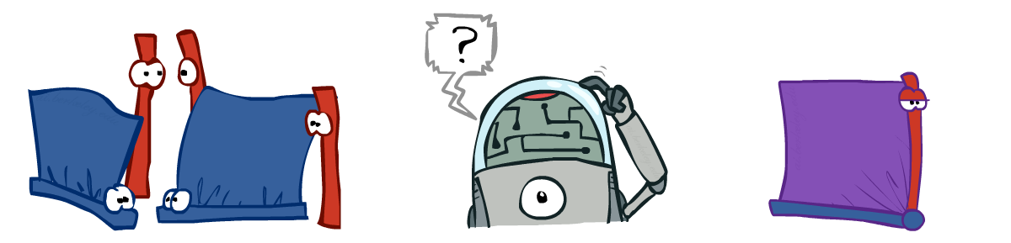
Inference
Inference: calculating some useful quantity from a joint probability distribution
Examples:
Posterior probability
Most likely explanation:
Notes:
Answer some useful query about a probability distribution.
Two use cases.
1. Determine the posterior probability of some query given some evidence.
2. Pick the most likely instantiation of the query variable given that evidence.
We’ll focus on the first one, but the second can be answered in a very similar way. You’ll change summations with maxes.

Slide 22
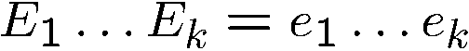
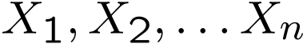
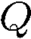
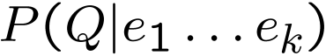
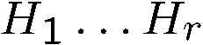
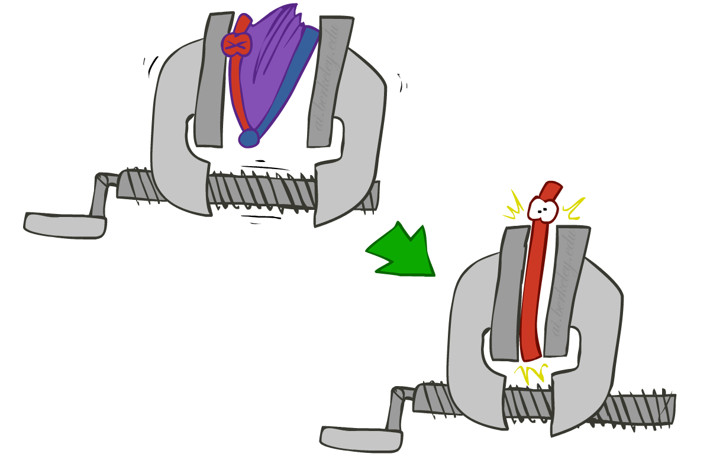
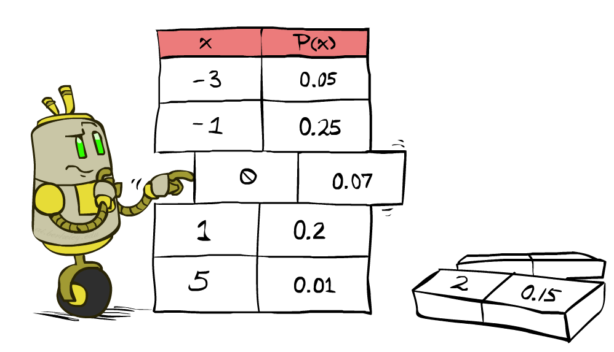
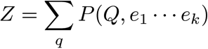
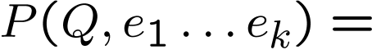
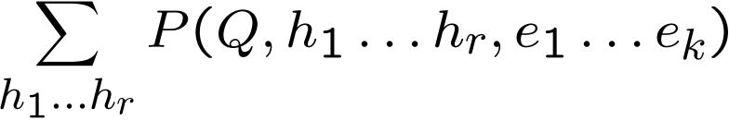
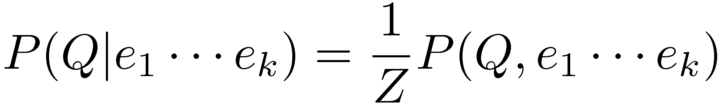
Inference by Enumeration
* Works fine with multiple query variables, too
General case:
Evidence variables:
Query* variable:
Hidden variables:
We want:
All variables
Step 1: Select the entries consistent with the evidence
Step 2: Sum out H to get joint of Query and evidence
Step 3: Normalize
Notes:
Inference by enumeration is something that we looked at before.
Evidence, query and hidden variables.
Hidden variables will be summed out. Then you’ve got the joint between the query and the evidence variables. That’s not what we want, so we normalize over the query variable.

Slide 23
Inference by Enumeration in Bayes’ Net
Given unlimited time, inference in BNs is easy
Reminder of inference by enumeration by example:
B
E
A
J
M
Notes:
Query: Distribution for Burglary given +j and +m
Step 1: The conditional is proportional to the joint between these variables. We’ll re-scale by the sum of the entires.
Step 2: Sum over the hidden variables.
Step 3: Definition of the joint distribution given the Bayes Net.
Finally, spell out the sum.
B is capital because that’s still a variable. We’re building a table for it.
What’s wrong with this? We have a nice compact rep with the BN. But we then build this full joint in the sum. This gets very expensive. It’s exponential in the number of non-evidence variables.

Slide 24
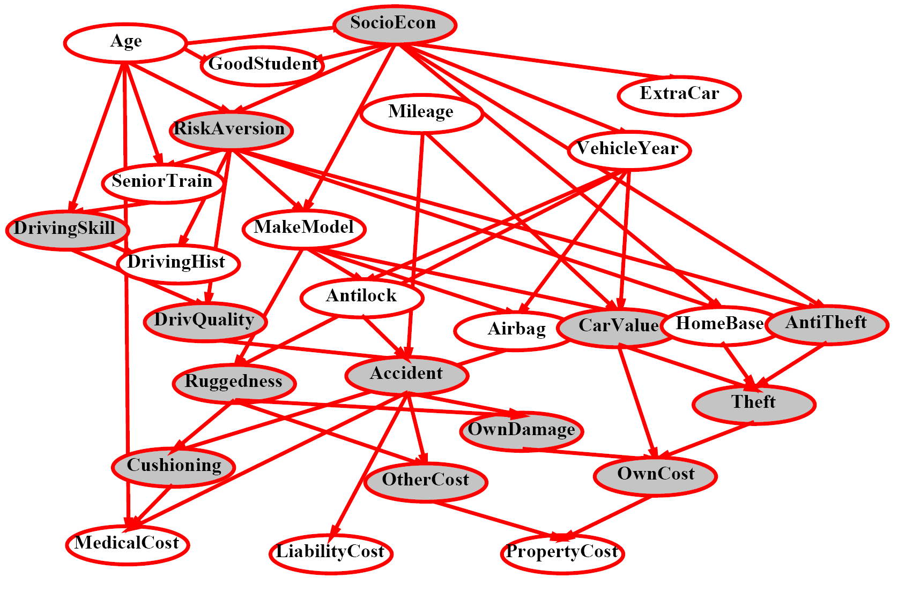
Inference by Enumeration?
Notes:
Shaded = observed.
Non-shaded= unobserved. 13 of those, so 2^13 items to compute. 2^13 = 8,192 Too big for a simple query like this.

Slide 25
Inference by Enumeration vs. Variable Elimination
Why is inference by enumeration so slow?
You join up the whole joint distribution before you sum out the hidden variables
Advanced technique: Variable Elimination
Interleave joining and marginalizing
Still NP-hard, but usually much faster than inference by enumeration
See the textbook for a description.
First we’ll need some new notation: factors

Slide 26
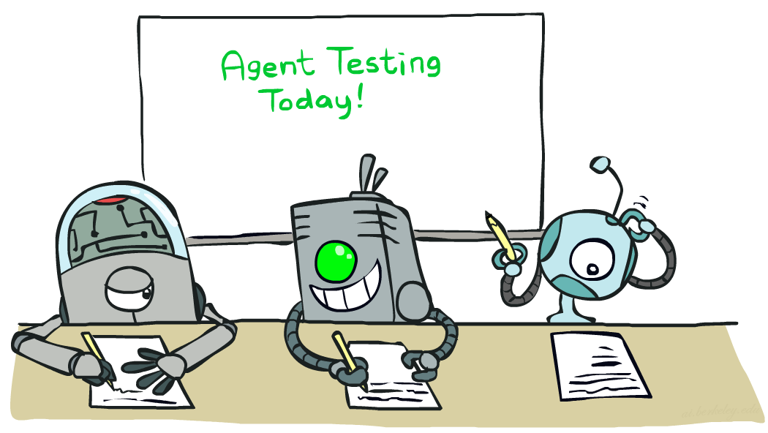

Naïve Bayes
Read AIMA 20.1-20.1
Slides courtesy of Dan Klein and Pieter Abbeel --- University of California, Berkeley
[These slides were created by Dan Klein and Pieter Abbeel for CS188 Intro to AI at UC Berkeley. All CS188 materials are available at http://ai.berkeley.edu.]
Notes:
Please retain proper attribution, including the reference to ai.berkeley.edu. Thanks!

Slide 27
Naïve Bayes
Read AIMA Section 20.1
Slides courtesy of Dan Klein and Pieter Abbeel --- University of California, Berkeley
[These slides were created by Dan Klein and Pieter Abbeel for CS188 Intro to AI at UC Berkeley. All CS188 materials are available at http://ai.berkeley.edu.]
Notes:
Please retain proper attribution, including the reference to ai.berkeley.edu. Thanks!

Slide 28
Machine Learning
Up until now: how use a model to make optimal decisions
Machine learning: how to acquire a model from data / experience
Learning parameters (e.g. probabilities)
Learning structure (e.g. BN graphs)
Learning hidden concepts (e.g. clustering)
Today: model-based classification with Naive Bayes

Slide 29

Classification

Slide 30
Example: Spam Filter
Input: an email
Output: spam/ham
Setup:
Get a large collection of example emails, each labeled “spam” or “ham”
Note: someone has to hand label all this data!
Want to learn to predict labels of new, future emails
Features: The attributes used to make the ham / spam decision
Words: FREE!
Text Patterns: $dd, CAPS
Non-text: SenderInContacts
…
Dear Sir.
First, I must solicit your confidence in this transaction, this is by virture of its nature as being utterly confidencial and top secret. …
TO BE REMOVED FROM FUTURE MAILINGS, SIMPLY REPLY TO THIS MESSAGE AND PUT "REMOVE" IN THE SUBJECT.
99 MILLION EMAIL ADDRESSES
FOR ONLY $99
Ok, Iknow this is blatantly OT but I'm beginning to go insane. Had an old Dell Dimension XPS sitting in the corner and decided to put it to use, I know it was working pre being stuck in the corner, but when I plugged it in, hit the power nothing happened.

Slide 31
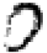
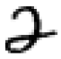

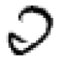
Example: Digit Recognition
Input: images / pixel grids
Output: a digit 0-9
Setup:
Get a large collection of example images, each labeled with a digit
Note: someone has to hand label all this data!
Want to learn to predict labels of new, future digit images
Features: The attributes used to make the digit decision
Pixels: (6,8)=ON
Shape Patterns: NumComponents, AspectRatio, NumLoops
…
0
1
2
1
??

Slide 32
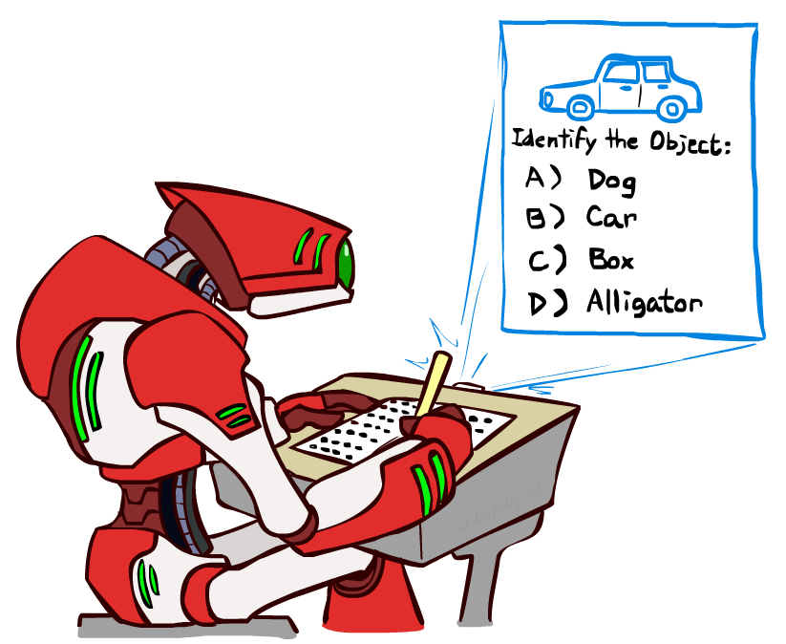
Other Classification Tasks
Classification: given inputs x, predict labels y
Examples:
Spam detection (input: document,
classes: spam / ham)
OCR (input: images, classes: characters)
Medical diagnosis (input: symptoms,
classes: diseases)
Automatic essay grading (input: document,
classes: grades)
Fraud detection (input: account activity,
classes: fraud / no fraud)
Customer service email routing
… many more
Classification is an important commercial technology!

Slide 33

Model-Based Classification

Slide 34
Model-Based Classification
Model-based approach
Build a model (e.g. Bayes’ net) where both the label and features are random variables
Instantiate any observed features
Query for the distribution of the label conditioned on the features
Challenges
What structure should the BN have?
How should we learn its parameters?

Slide 35

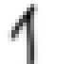
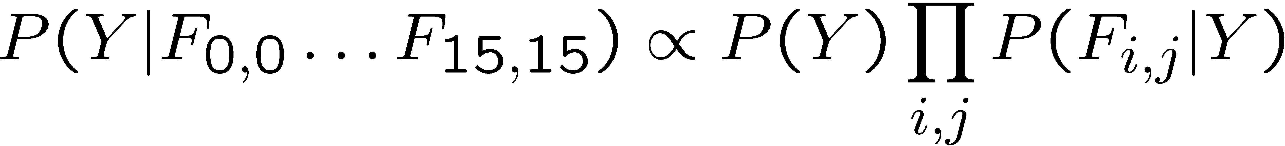
Naïve Bayes for Digits
Naïve Bayes: Assume all features are independent effects of the label
Simple digit recognition version:
One feature (variable) F_{ij} for each grid position <i,j>
Feature values are on / off, based on whether intensity
is more or less than 0.5 in underlying image
Each input maps to a feature vector, e.g.
Here: lots of features, each is binary valued
Naïve Bayes model:
What do we need to learn?
Y
F₁
F₂
F_{n}

Slide 36

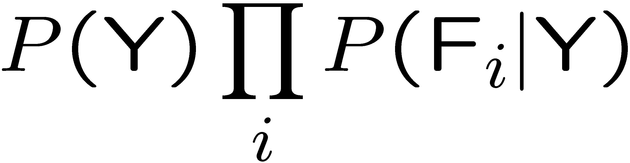
General Naïve Bayes
A general Naive Bayes model:
We only have to specify how each feature depends on the class
Total number of parameters is linear in number of features
Model is very simplistic, but often works anyway
Y
|Y| labels
F₁
F₂
F_{n}
|Y| x |F|^{n} values
n x |F| x |Y| parameters

Slide 37
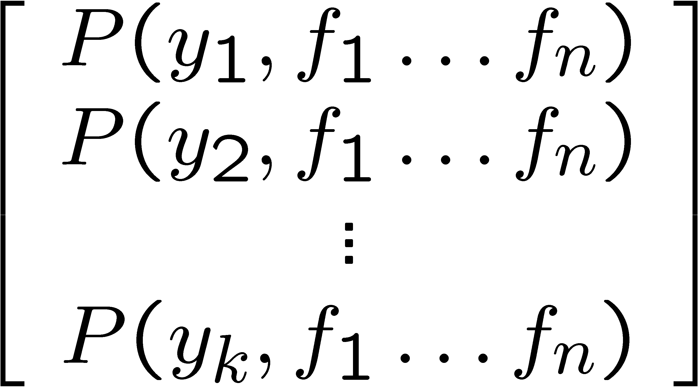
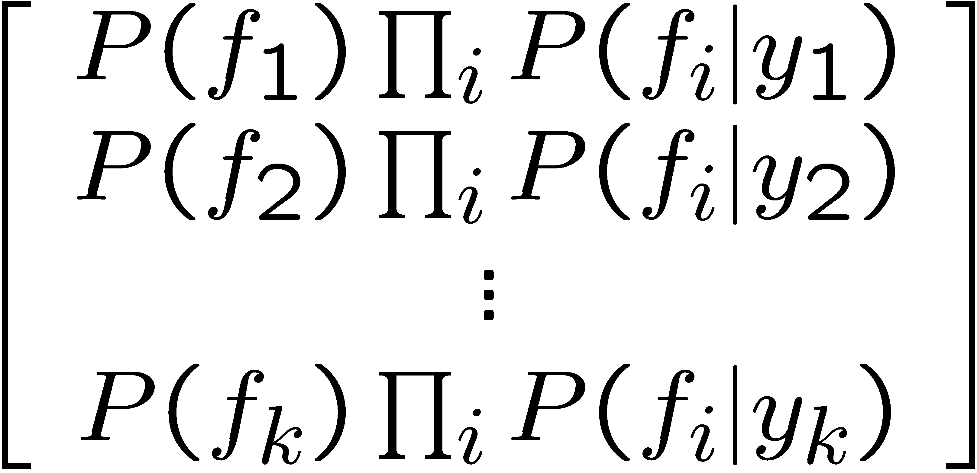

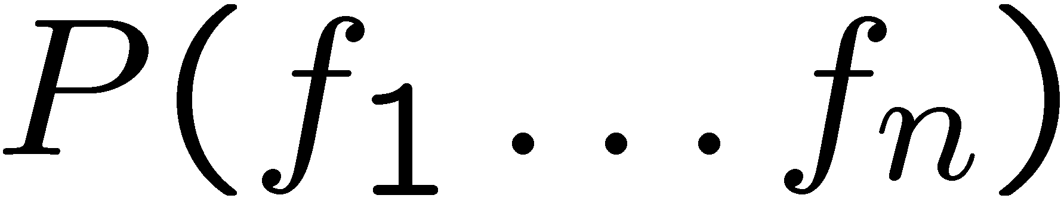
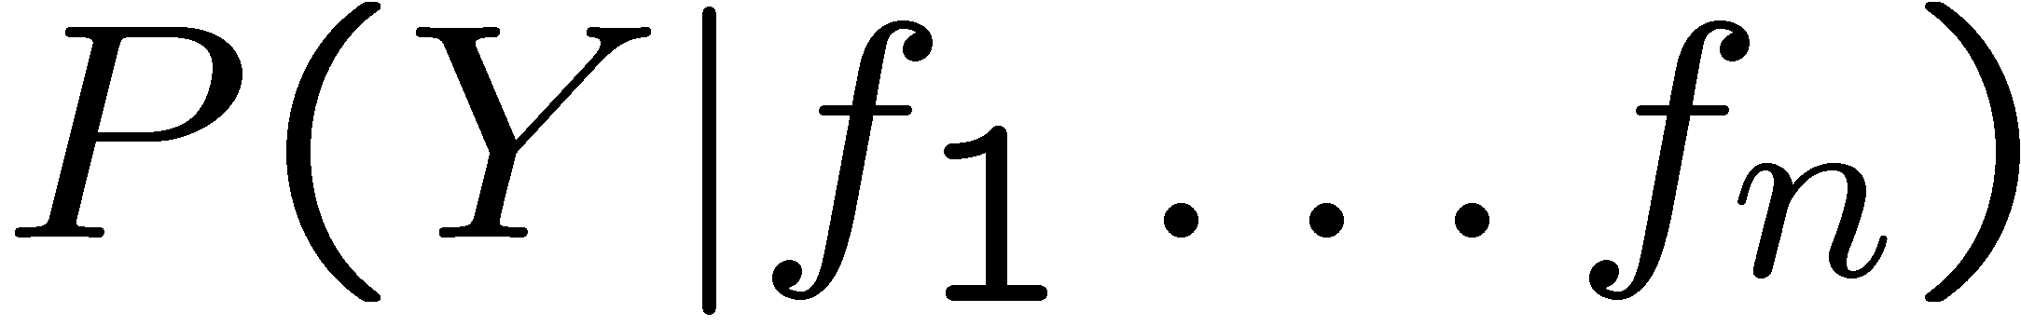
Inference for Naïve Bayes
Goal: compute posterior distribution over label variable Y
Step 1: get joint probability of label and evidence for each label
Step 2: sum to get probability of evidence
Step 3: normalize by dividing Step 1 by Step 2
+

Slide 38
General Naïve Bayes
What do we need in order to use Naïve Bayes?
Inference method (we just saw this part)
Start with a bunch of probabilities: P(Y) and the P(F_{i}|Y) tables
Use standard inference to compute P(Y|F₁…F_{n})
Nothing new here
Estimates of local conditional probability tables
P(Y), the prior over labels
P(F_{i}|Y) for each feature (evidence variable)
These probabilities are collectively called the parameters of the model and denoted by θ
Up until now, we assumed these appeared by magic, but…
…they typically come from training data counts: we’ll look at this soon

Slide 39
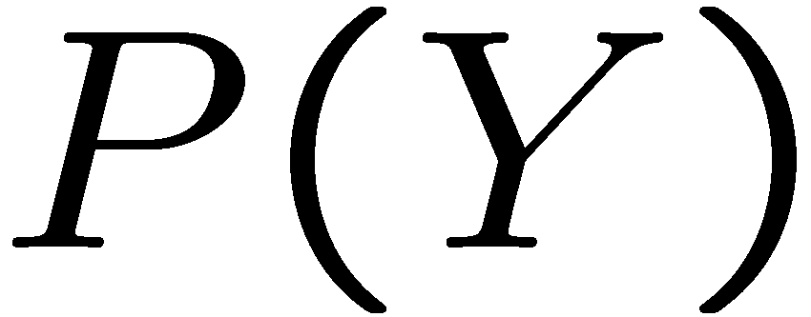
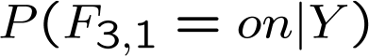

Example: Conditional Probabilities
1 | 0.1
2 | 0.1
3 | 0.1
4 | 0.1
5 | 0.1
6 | 0.1
7 | 0.1
8 | 0.1
9 | 0.1
0 | 0.1
1 | 0.01
2 | 0.05
3 | 0.05
4 | 0.30
5 | 0.80
6 | 0.90
7 | 0.05
8 | 0.60
9 | 0.50
0 | 0.80
1 | 0.05
2 | 0.01
3 | 0.90
4 | 0.80
5 | 0.90
6 | 0.90
7 | 0.25
8 | 0.85
9 | 0.60
0 | 0.80

Slide 40
A Spam Filter
Naïve Bayes spam filter
Data:
Collection of emails, labeled spam or ham
Note: someone has to hand label all this data!
Split into training, held-out, test sets
Classifiers
Learn on the training set
(Tune it on a held-out set)
Test it on new emails
Dear Sir.
First, I must solicit your confidence in this transaction, this is by virture of its nature as being utterly confidencial and top secret. …
TO BE REMOVED FROM FUTURE MAILINGS, SIMPLY REPLY TO THIS MESSAGE AND PUT "REMOVE" IN THE SUBJECT.
99 MILLION EMAIL ADDRESSES
FOR ONLY $99
Ok, Iknow this is blatantly OT but I'm beginning to go insane. Had an old Dell Dimension XPS sitting in the corner and decided to put it to use, I know it was working pre being stuck in the corner, but when I plugged it in, hit the power nothing happened.

Slide 41

Naïve Bayes for Text
Bag-of-words Naïve Bayes:
Features: W_{i} is the word at positon i
As before: predict label conditioned on feature variables (spam vs. ham)
As before: assume features are conditionally independent given label
New: each W_{i} is identically distributed
Generative model:
“Tied” distributions and bag-of-words
Usually, each variable gets its own conditional probability distribution P(F|Y)
In a bag-of-words model
Each position is identically distributed
All positions share the same conditional probs P(W|Y)
Why make this assumption?
Called “bag-of-words” because model is insensitive to word order or reordering
Word at position i, not i^{th} word in the dictionary!

Slide 42



Example: Spam Filtering
Model:
What are the parameters?
Where do these tables come from?
ham : 0.66
spam: 0.33
the : 0.0156
to : 0.0153
and : 0.0115
of : 0.0095
you : 0.0093
a : 0.0086
with: 0.0080
from: 0.0075
...
the : 0.0210
to : 0.0133
of : 0.0119
2002: 0.0110
with: 0.0108
from: 0.0107
and : 0.0105
a : 0.0100
...

Slide 43
Spam Example
Word | P(w|spam) | P(w|ham) | Tot Spam | Tot Ham
(prior) | 0.33333 | 0.66666 | -1.1 | -0.4
Gary | 0.00002 | 0.00021 | -11.8 | -8.9
would | 0.00069 | 0.00084 | -19.1 | -16.0
you | 0.00881 | 0.00304 | -23.8 | -21.8
like | 0.00086 | 0.00083 | -30.9 | -28.9
to | 0.01517 | 0.01339 | -35.1 | -33.2
lose | 0.00008 | 0.00002 | -44.5 | -44.0
weight | 0.00016 | 0.00002 | -53.3 | -55.0
while | 0.00027 | 0.00027 | -61.5 | -63.2
you | 0.00881 | 0.00304 | -66.2 | -69.0
sleep | 0.00006 | 0.00001 | -76.0 | -80.5
P(spam | w) = 98.9

Slide 44



Training and Testing

Slide 45



Important Concepts
Data: labeled instances, e.g. emails marked spam/ham
Training set
Held out set
Test set
Features: attribute-value pairs which characterize each x
Experimentation cycle
Learn parameters (e.g. model probabilities) on training set
(Tune hyperparameters on held-out set)
Compute accuracy of test set
Very important: never “peek” at the test set!
Evaluation
Accuracy: fraction of instances predicted correctly
Overfitting and generalization
Want a classifier which does well on test data
Overfitting: fitting the training data very closely, but not generalizing well
We’ll investigate overfitting and generalization formally in a few lectures
Training
Data
Held-Out
Data
Test
Data

Slide 46



Generalization and Overfitting

Slide 47
Overfitting
30
25
20
Degree 15 polynomial
15
10
5
0
-5
-10
-15
0
2
4
6
8
10
12
14
16
18
20

Slide 48












Example: Overfitting
2 wins!!

Slide 49


Example: Overfitting
Posteriors determined by relative probabilities (odds ratios):
south-west : inf
nation : inf
morally : inf
nicely : inf
extent : inf
seriously : inf
...
screens : inf
minute : inf
guaranteed : inf
$205.00 : inf
delivery : inf
signature : inf
...
What went wrong here?

Slide 50
Generalization and Overfitting
Relative frequency parameters will overfit the training data!
Just because we never saw a 3 with pixel (15,15) on during training doesn’t mean we won’t see it at test time
Unlikely that every occurrence of “minute” is 100% spam
Unlikely that every occurrence of “seriously” is 100% ham
What about all the words that don’t occur in the training set at all?
In general, we can’t go around giving unseen events zero probability
As an extreme case, imagine using the entire email as the only feature
Would get the training data perfect (if deterministic labeling)
Wouldn’t generalize at all
Just making the bag-of-words assumption gives us some generalization, but isn’t enough
To generalize better: we need to smooth or regularize the estimates

Slide 51

Parameter Estimation

Slide 52




Parameter Estimation
Estimating the distribution of a random variable
Elicitation: ask a human (why is this hard?)
Empirically: use training data (learning!)
E.g.: for each outcome x, look at the empirical rate of that value:
This is the estimate that maximizes the likelihood of the data
r
b
b
b
r
r
b
b
b
r
r
b
b
b
b
r
r
b

Slide 53


Maximum Likelihood
Relative frequencies are the maximum likelihood estimates

Slide 54


Unseen Events

Slide 55




Laplace Smoothing
Laplace’s estimate:
Pretend you saw every outcome once more than you actually did
Can derive this estimate with Dirichlet priors
r
r
b

Slide 56





Laplace Smoothing
Laplace’s estimate (extended):
Pretend you saw every outcome k extra times
What’s Laplace with k = 0?
k is the strength of the prior
Laplace for conditionals:
Smooth each condition independently:
r
r
b

Slide 57
Estimation: Linear Interpolation*
In practice, Laplace often performs poorly for P(X|Y):
When |X| is very large
When |Y| is very large
Another option: linear interpolation
Also get the empirical P(X) from the data
Make sure the estimate of P(X|Y) isn’t too different from the empirical P(X)
What if α is 0? 1?
For even better ways to estimate parameters, take CIS 530 next semester. ☺

Slide 58
Real NB: Smoothing
For real classification problems, smoothing is critical
New odds ratios:
helvetica : 11.4
seems : 10.8
group : 10.2
ago : 8.4
areas : 8.3
...
verdana : 28.8
Credit : 28.4
ORDER : 27.2
<FONT> : 26.9
money : 26.5
...
Do these make more sense?
Notes:
None of these are infinity.

Slide 59

Tuning

Slide 60








Tuning on Held-Out Data
Now we’ve got two kinds of unknowns
Parameters: the probabilities P(X|Y), P(Y)
Hyperparameters: e.g. the amount / type of smoothing to do, k, α
What should we learn where?
Learn parameters from training data
Tune hyperparameters on different data
Why?
For each value of the hyperparameters, train and test on the held-out data
Choose the best value and do a final test on the test data

Slide 61

Features

Slide 62
Errors, and What to Do
Examples of errors
Dear GlobalSCAPE Customer,
GlobalSCAPE has partnered with ScanSoft to offer you the latest version of OmniPage Pro, for just $99.99* - the regular list price is $499! The most common question we've received about this offer is - Is this genuine? We would like to assure you that this offer is authorized by ScanSoft, is genuine and valid. You can get the . . .
. . . To receive your $30 Amazon.com promotional certificate, click through to
http://www.amazon.com/apparel
and see the prominent link for the $30 offer. All details are there. We hope you enjoyed receiving this message. However, if you'd rather not receive future e-mails announcing new store launches, please click . . .

Slide 63

What to Do About Errors?
Need more features– words aren’t enough!
Have you emailed the sender before?
Have 1K other people just gotten the same email?
Is the sending information consistent?
Is the email in ALL CAPS?
Do inline URLs point where they say they point?
Does the email address you by (your) name?
Can add these information sources as new variables in the NB model
Next class we’ll talk about classifiers which let you easily add arbitrary features more easily

Slide 64
Baselines
First step: get a baseline
Baselines are very simple “straw man” procedures
Help determine how hard the task is
Help know what a “good” accuracy is
Weak baseline: most frequent label classifier
Gives all test instances whatever label was most common in the training set
E.g. for spam filtering, might label everything as ham
Accuracy might be very high if the problem is skewed
E.g. calling everything “ham” gets 66%, so a classifier that gets 70% isn’t very good…
For real research, usually use previous work as a (strong) baseline

Slide 65


Confidences from a Classifier
The confidence of a probabilistic classifier:
Posterior over the top label
Represents how sure the classifier is of the classification
Any probabilistic model will have confidences
No guarantee confidence is correct
Calibration
Weak calibration: higher confidences mean higher accuracy
Strong calibration: confidence predicts accuracy rate
What’s the value of calibration?

Slide 66
Summary
Bayes rule lets us do diagnostic queries with causal probabilities
The naïve Bayes assumption takes all features to be independent given the class label
We can build classifiers out of a naïve Bayes model using training data
Smoothing estimates is important in real systems
Classifier confidences are useful, when you can get them

Slide 67
Next Time: Perceptron!

